Slide 1
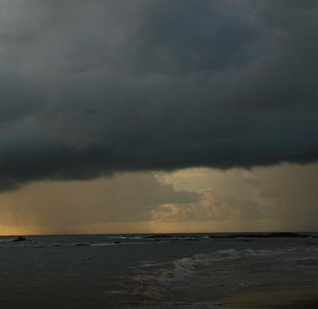
Water cycle
Source: https://climate.nasa.gov/quizzes/water-cycle/ (2022)

Slide 2
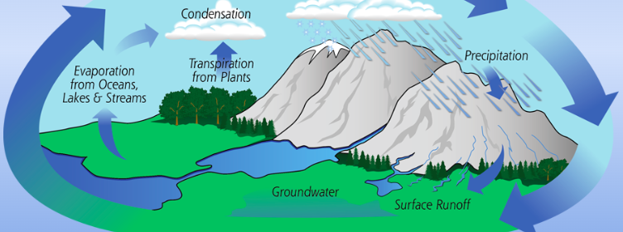
https://gpm.nasa.gov/education/interactive/water-cycle-webquest
Earth‘s water is stored in ice and snow, lakes and rivers, in the atmosphere and the oceans.
How much do you know about how water cycles around our planet and the crucial role it plays in our climate?
Start

Slide 3
The 3 states of matter are…
liquid, solid and gasous.

Slide 5
surface =
Oberfläche

Slide 6
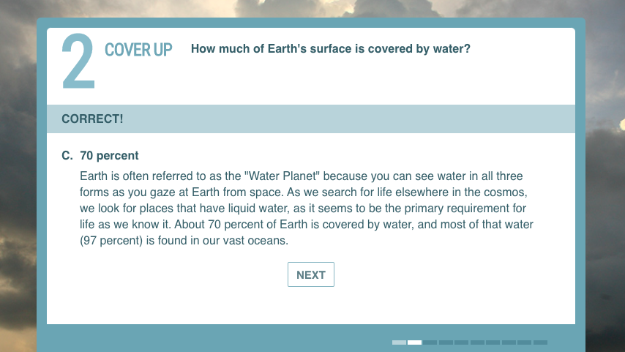

Slide 7
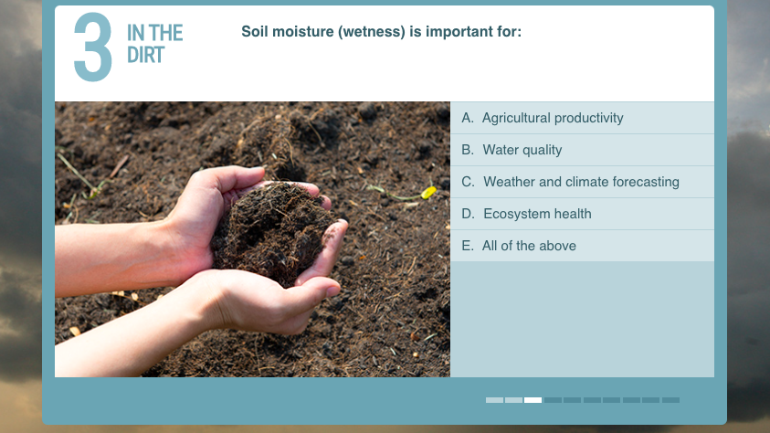
soil =
Boden

Slide 8
crop yield =
Ernteertrag

Slide 10
a sysnonym for to occur =
= Niederschlag
to take place

Slide 17
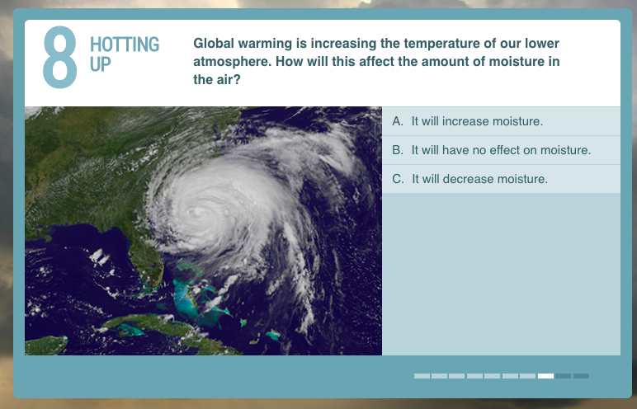

Slide 18
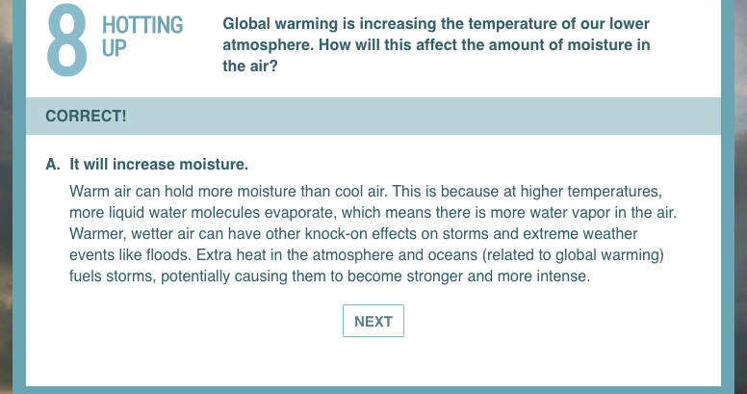
The comparison (Steigerung) of warm, wet, strong
but:
warmer, wetter, stronger
intense
-> more intense

Slide 20
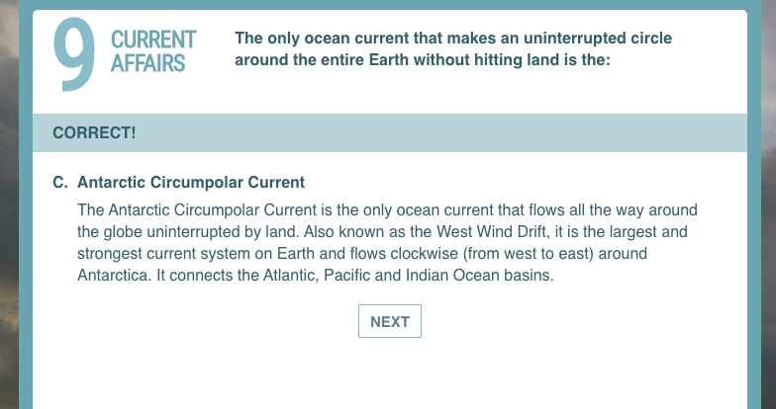

Slide 22
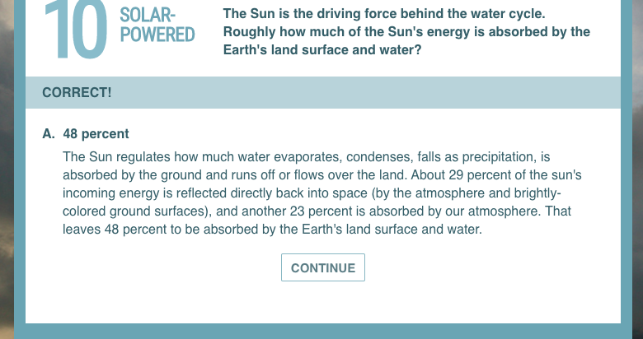

Slide 23
Congratulations!
You scored 10 out of 10.
Source: https://climate.nasa.gov/quizzes/water-cycle/ (2022)

Slide 24
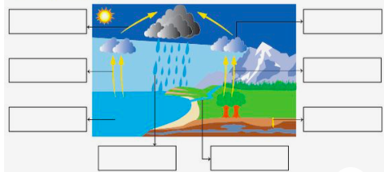
Label the diagram
Source: https://www.pinterest.de/pin/48624870963118665/?nic_v3=1a4CLM4yV (2022)

Slide 25
Solution - Label the diagram.
Condensation
Transportation
Evaporation
Transpiration
Accumulation
Perlocation
Precipitation
Surface Runoff
Source: https://www.pinterest.de/pin/48624870963118665/?nic_v3=1a4CLM4yV (2022)

